Slide 1


COMPUTER SYSTEMS FUNDAMENTALS
Multi-Core Architecture,
OS, Threads &
Synchronization
Hardware · Operating Systems · Threads · Performance

Slide 2
Presentation Members
Kerollos Akram
Abdelrahman Tarek
Basel Ashraf
Omar Mohamed
Omar Mohamed

Slide 3
PART 1
Hardware
Multi-Core Architecture

Slide 4
1.1 — Physical Core
A CPU core is the fundamental execution unit inside a processor, responsible for fetching, decoding, and executing instructions.
ALU – Arithmetic Logic Unit
Registers
Core Function
Performs all arithmetic & logical operations
Addition, subtraction, multiplication, division
Logical comparisons: >, <, =
Extremely small, extremely fast memory inside the CPU
Temporarily stores data being actively processed
Directly accessible by the ALU
Combines control logic, ALU, and registers
Executes instructions sequentially
Example: x = a + b → ALU adds, registers hold a, b, x

Slide 5
1.2 — Parallelism vs Concurrency
Concurrency
Parallelism
Multiple tasks managed by rapidly switching on a SINGLE core
Only ONE task executes at any given instant
Appears simultaneous — but is NOT
Example: Core switches Task A → Task B → Task C rapidly
Think: one chef cooking multiple dishes by multitasking
Multiple cores execute tasks SIMULTANEOUSLY
TRUE simultaneous execution
Requires multiple physical cores
Example: Core 1 → Task A, Core 2 → Task B, Core 3 → Task C
Think: three chefs each cooking a different dish at once

Slide 6
1.3 — Cache Architecture: Private vs Shared
Modern processors use a hierarchical cache system to reduce memory latency.
Private Cache — L1 & L2
Shared Cache — L3
Each core has its own private L1 and L2 cache
L1: Smallest and fastest, located directly inside the core
L2: Larger than L1, still private to each core
✅ Advantage: Extremely fast, no interference from other cores
⚠️ Disadvantage: Data duplication across cores may occur
L3 cache is shared among ALL cores in the processor
Acts as shared memory space between cores
Reduces need to access slower main memory (RAM)
Example: Core 1 modifies data → Core 2 retrieves it from L3
✅ Efficient sharing ⚠️ Higher contention

Slide 7

1.4 — Cache Coherency & The MESI Protocol
In multi-core systems, multiple cores may store copies of the same data. Modifications cause inconsistencies — MESI solves this.
⚠️ Problem: Core 1 holds X=10 · Core 2 holds X=10 · Core 1 updates X to 20 · Core 2 still sees X=10 ❌
M
E
S
I
Modified
Exclusive
Shared
Invalid
Data changed in this cache, differs from RAM
Only in one cache, matches RAM
In multiple caches, identical across all
Stale — must not be used

Slide 8
1.4 — MESI Protocol: Step-by-Step
Step 1 — Initial State
Step 2 — Core 1 Updates X
Step 3 — Core 2 Requests X
Core 1: X = 10 → State: Shared (S)
Core 2: X = 10 → State: Shared (S)
Both cores hold identical, valid copies
Core 1 changes X from 10 → 20
Core 1 state → Modified (M)
Core 2 state → Invalid (I) immediately
Core 2's copy is now outdated/stale
Core 2 detects its copy is Invalid
Retrieves updated value from Core 1 or RAM
Synchronization completes successfully
Both cores now have consistent data ✅

Slide 9
1.5 — Thermal Limits & Multi-Core Design
Why Clock Speed Can't Scale Forever
✅ Multi-Core Solution
Higher frequency → more transistor switching activity
Power consumption rises significantly
Heat generation rises exponentially
Use many cores at moderate frequency instead of one fast core
❌ Wrong approach: 1 core at extreme frequency → heat + instability
✅ Correct approach: Multiple cores at moderate frequency
Parallel execution with controlled thermal output
Modern CPUs: 8, 16, 32+ cores built on this principle
Thermal Throttling
CPU auto-reduces speed at critical temperature
Example: 3.5 GHz → reduced to 2.5 GHz under heavy load
Physical 'thermal wall' prevents unlimited frequency scaling

Slide 10
PART 2
Operating Systems
Processes & Multiprocessing

Slide 11
2.1 — Process Anatomy
A process is a program in execution. Its memory layout is divided into four distinct segments:
Code (Text) Segment
Data Segment
Contains executable instructions. Usually read-only. Shared across threads.
Stores global and static variables. Exists for the entire lifetime of the process.
Heap
Stack
Dynamic memory allocation. Grows upward as objects are created at runtime.
Stores function calls, local variables, and return addresses. Grows downward.

Slide 12
2.2 — Isolation, Security & Virtual Memory
Process Isolation & Security
Virtual Memory & Page Table
Each process has its own Virtual Address Space
A process CANNOT access memory of another process
Enforced by hardware: Memory Management Unit (MMU)
Unauthorized access → Segmentation Fault (crash)
Virtual memory gives each process the illusion of its own memory
Memory divided into: Pages (virtual) and Frames (physical)
Page Table maps Page Number → Frame Number
Virtual Address = (Page Number, Offset)
Physical Address = (Frame Number, Offset)
Enables safe and efficient memory management
Why Isolation Matters
Ensures system security — malicious process can't read other data
Ensures system stability — one crash doesn't bring down others

Slide 13

2.3 — Context Switching
A context switch occurs when the CPU transitions from executing one process to another.
Steps of a Context Switch
Cost — Overhead
1. Save the current process state (registers, program counter, etc.)
2. Load the next process state from memory/PCB
3. Resume execution of the newly loaded process
Time spent saving and restoring CPU state
Cache invalidation — cached data becomes stale
CPU pipeline disruption — must refill instruction pipeline
Frequent switching significantly reduces performance
💡 Key Insight: More cores = less need for context switching = more true parallel execution = better performance.

Slide 14
2.4 — Multi-Core vs Multi-CPU
Multi-Core
Multi-CPU
A single CPU chip containing multiple cores
Faster internal communication between cores
Lower cost and lower power consumption
Cores share L3 cache
Common in consumer desktops, laptops, and phones
Multiple separate physical CPU chips on one motherboard
Higher scalability for massive enterprise workloads
Communication goes through external bus — slower
Higher cost and much higher power consumption
Used in high-end servers and workstations

Slide 15
2.5 — OS System Overview
1
Virtual Address Space
2
MMU & Page Table
Each process runs in complete isolation with its own virtual address space
Hardware MMU and OS Page Table handle memory translation and protection
3
OS Scheduler
4
Context Switching
Distributes processes and threads across available CPU cores dynamically
OS enables multitasking by saving/restoring process state on core switches

Slide 16
PART 3
Threads &
Multithreading

Slide 17

3.1 — What is a Thread?
A thread is the smallest unit of execution inside a process — a lightweight path that executes instructions independently while sharing resources with other threads in the same process.
Process vs Thread
Structure Inside a Process
Process: Independent program with its own complete memory space
Thread: Execution unit INSIDE a process sharing process memory
A single process can contain multiple threads
Thread = lightweight | Process = heavyweight
Process
→ Thread 1: executes independently
→ Thread 2: executes independently
→ Thread 3: executes independently
All threads share the same memory space

Slide 18
3.2 — Shared vs Private Resources
Shared Resources — All Threads
Private Resources — Per Thread
Code segment (program instructions)
Heap — dynamic memory
Global variables
Open file handles and network sockets
→ Allows threads to communicate easily and efficiently
Example: A global counter can be read/written by all threads
Stack — function call frames
Local variables (each thread has its own copy)
Function calls and return addresses
Execution context: registers, program counter
→ Ensures each thread can execute independently
Example: A local loop counter is separate for each thread

Slide 19
3.3 — Why Threads Are Faster Than Processes
Creating a Process — Expensive
Creating a Thread — Lightweight
Requires allocating a new memory space
Requires a new virtual address space
Requires building a new page table
All operations take significant time and OS resources
Shares the existing process memory — no duplication
Shares the existing address space and page table
Only a new stack is allocated for the new thread
Much faster creation and far lower overhead
Conclusion: Use threads when tasks share data and need speed. Use processes when isolation and fault tolerance are required.

Slide 20
3.4 — Real-World Use Case: GUI Applications
Modern applications use multithreading to stay responsive while performing background operations.
🖥️ UI Thread
⚙️ Background Thread
Handles user interface: buttons, clicks, display updates
Remains responsive and smooth at all times
Performs file loading, network requests, heavy computation
Runs independently without blocking the UI
❌ Without multithreading: The application FREEZES during any long-running operation.
✅ With multithreading: The UI stays fully responsive while background tasks run concurrently.

Slide 21
PART 4
Synchronization
Mutex, Deadlock & Starvation &Race Condition

Slide 22
4.1 — Race Condition
A race condition occurs when multiple threads access and modify shared data simultaneously without proper synchronization.
Why It Happens
Example: count starts at 5
count = count + 1 is NOT atomic — it is 3 CPU steps:
1. READ: Retrieve current value of count
2. INCREMENT: Add 1 to the value
3. STORE: Save the new value back to memory
If two threads interleave between these steps → data is corrupted
Thread A reads count = 5
Thread B reads count = 5 (before A stores!)
Thread A computes 5+1=6, stores 6
Thread B computes 5+1=6, stores 6
Final result: 6 ❌ Expected: 7
Root cause: CPU interleaves threads at unpredictable points

Slide 23
## Step-by-Step Execution (The Problem)
Consider the following scenario:
**count = 0**
**Thread A begins:**
Reads count → 0
**Thread B starts before A completes:**
Reads count → 0
**Thread A proceeds:**
Increments → 1
Writes count = 1
**Thread B continues:**
Increments → 1 (using the previous value of 0)
Writes count = 1
*Final Result:**
count = 1
However, it should have been:
count = 2
This situation is referred to as a *Race Condition*, as both threads "raced" for the same data.

Slide 24
4.2 — Mutex (Mutual Exclusion Lock)
To prevent race conditions, we use a Mutex. A mutex ensures only ONE thread can access a shared resource at any given time.
1
Thread A acquires the lock
2
Thread B is blocked
Thread A reads and increments the shared value. It holds the mutex exclusively.
Thread B tries to acquire the lock but is forced to wait — it is blocked until A releases.
3
Thread A releases the lock
4
Thread B acquires the lock
Thread A completes its work and releases the mutex, signalling the system.
Thread B wakes up, acquires the lock, reads the updated value, and increments correctly.

Slide 25
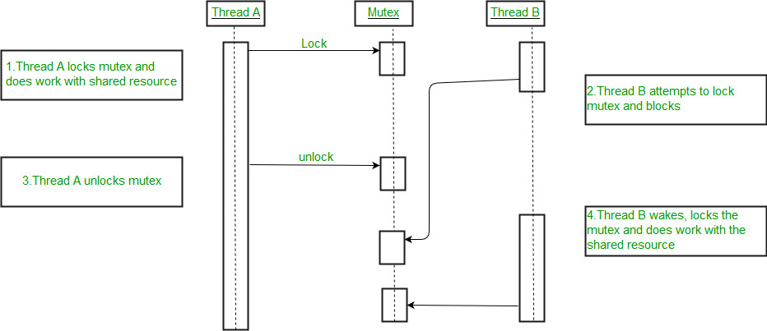

Slide 26
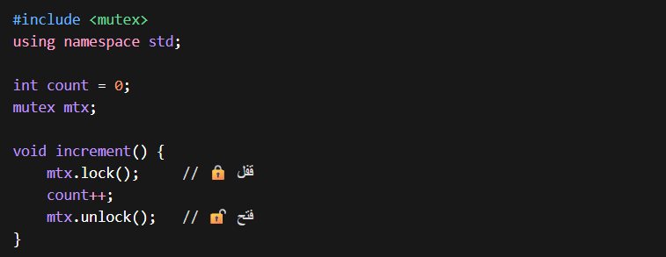

Slide 27

4.3 — The Deadlock Problem
A deadlock is a state where threads are unable to proceed because each waits for the other to release a resource — like a traffic jam where nothing moves.
❌ Deadlock Scenario
✅ Simple Fix
Thread A: Locks m1, then tries to lock m2
Thread B: Locks m2, then tries to lock m1
→ A holds m1, waits for m2
→ B holds m2, waits for m1 → STUCK FOREVER
Make both threads acquire locks in the SAME ORDER
Thread A: Lock m1 → Lock m2
Thread B: Lock m1 → Lock m2
No circular wait → No deadlock!
Four Necessary Conditions (ALL must hold simultaneously):
Mutual Exclusion
Hold & Wait
No Preemption
Circular Wait
Only 1 thread can use a resource at a time
Thread holds a resource while waiting for another
Resources must be released voluntarily
Closed chain — each thread waits for the next

Slide 28
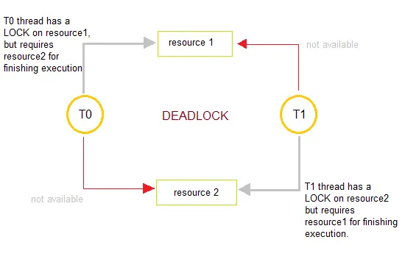

Slide 29
Understanding Deadlock in Multithreading
Scenario:
Thread A locks m1 and attempts to lock m2.
Thread B locks m2 and tries to lock m1.
Issue :
Both threads execute simultaneously, leading to:
Thread A waits for m2 .
Thread B waits for m1 .
Outcome:
Deadlock occurs as neither thread can proceed.
Summary:
Thread A holds m1 and waits for m2 .
Thread B holds m2 and waits for m1.

Slide 30
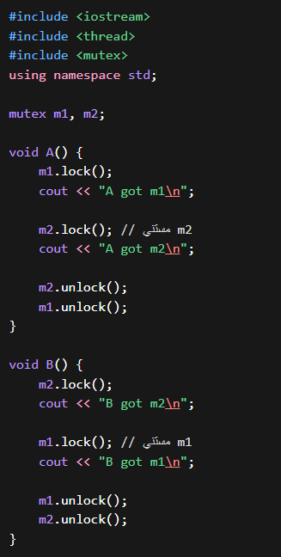


Slide 31

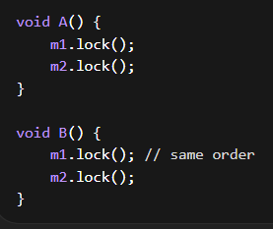


Slide 32

4.4 — Starvation
Starvation occurs when a low-priority thread is continuously denied CPU resources because higher-priority threads keep getting executed instead — it may NEVER run.
How Starvation Occurs
Prevention Strategies
Scheduler always picks the highest-priority thread first
High-priority threads continuously arrive in a stream
Low-priority thread is perpetually delayed
May never get CPU time — effectively frozen
Similar to a busy checkout aisle that never clears
Aging: Gradually increase a thread's priority as it waits
Fair scheduling: Round Robin, Lottery scheduling
Priority ceiling / priority inheritance protocols
Ensure every thread eventually gets its turn on the CPU

Slide 33
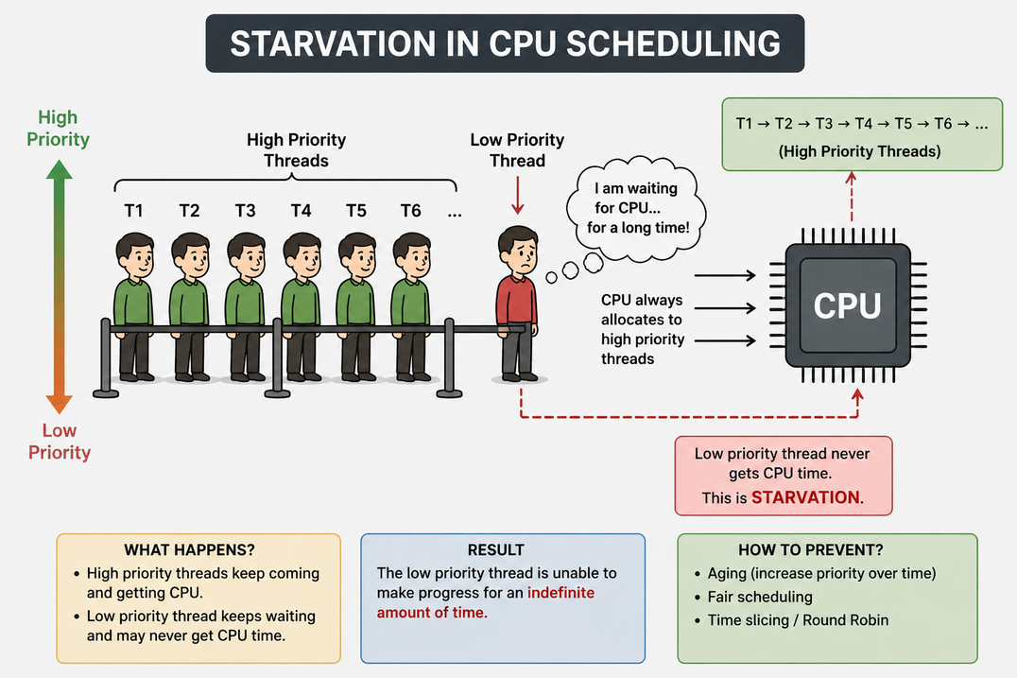

Slide 34
PART 5
Performance Strategy
Amdahl's Law & Load Balancing

Slide 35
5.1 — Amdahl's Law
Defines the theoretical limit of speedup when a program is parallelized. The serial portion always creates a bottleneck.
Speedup = 1 ÷ [ (1 − P) + (P ÷ N) ]
P = fraction parallelizable · N = number of cores
⚠️ Key Insight
✅ Conclusion
The serial portion of a program is a hard bottleneck
This limits max speedup regardless of core count
Example: 50% serial program → max 2× speedup ever
Even with infinite cores, serial code must run sequentially
Adding cores only helps up to a limit
The more serial the program, the lower the benefit
To gain real speedup, minimize serial code sections
Parallelism requires algorithm-level design thinking

Slide 36
5.2 — Load Balancing
Load balancing distributes tasks evenly across all processing units to maximize resource utilization and minimize execution time.
Role of the OS Scheduler
Objective
Assigns processes or threads to specific CPU cores
Ensures no single core is overloaded while others are idle
Dynamically adjusts task distribution during execution
Achieve efficient utilization of ALL available cores
Reduce idle time and prevent performance bottlenecks
Maximize overall throughput of the entire system
Example (4-core system):
❌ Poor: Core 1 at 100% load · Cores 2, 3, 4 idle ✅ Good: All 4 cores share the workload evenly

Slide 37
5.3 — Multi-Processing vs Multi-Threading
Multi-Processing
Multi-Threading
Multiple independent processes, each with its own memory
Processes are fully isolated from each other
Communication requires IPC (Inter-Process Communication) — costly
More robust and fault-tolerant (one crash doesn't affect others)
Suitable for: heavy independent tasks, high-reliability systems
Examples: Web servers handling requests, browser tabs
Multiple threads within the same process, sharing memory
Threads share the same memory space efficiently
Lower overhead compared to process creation
Faster inter-thread communication (shared memory)
Suitable for: tasks needing frequent data sharing
Examples: Game engines, UI apps with background tasks

Slide 38
Complete Summary
Part 1 — Hardware
CPU cores (ALU, registers), parallelism vs concurrency, L1/L2/L3 cache, MESI protocol, thermal limits → multi-core solution
Part 2 — OS & Processes
Process anatomy (code/data/heap/stack), virtual memory, MMU/page table, context switching, multi-core vs multi-CPU
Part 3 — Threads
Thread definition, shared vs private resources, why threads are faster, race conditions, multithreading in GUI apps
Part 4 — Synchronization
Mutex/locks for race conditions, deadlock (4 conditions + fix: consistent lock order), starvation and prevention
Part 5 — Performance
Amdahl's Law (serial bottleneck limits parallelism), load balancing by OS scheduler, multi-processing vs multi-threading

